Slide 1
2018 PHEP Grant Workshops

Slide 2
Binder & Handouts
Front of Binder
Agenda
SME Contact List
Customer Service Map
Tab A
Contract/Task Order
Funding Table for Next year
Quick Guide for Deliverables
Attachment A
Tab B – L
SME Handouts
Handouts
Trailer Brochure
Montana Preparedness Report from CDC

Slide 4
Grant, Contract Overview Budget, COOP, and Admin Deliverables
Kevin O’Loughlin
PHEP Supervisor

Slide 5
Public Health Preparedness Capabilities
Enhance local public health capacity to respond to events impacting the public health, through planning, assessment and development of critical capacities as defined by the CDC’s public health preparedness capabilities
Activities must be within the CDCs 15 Preparedness Capabilities
Community Preparedness
Community Recovery
Emergency Operation Coordination
Emergency Public Information and Warning
Fatality Management
Information Sharing
Mass Care
Medical Countermeasure Dispensing
Medical Materiel Management and Distribution
Medical Surge
Non-Pharmaceutical Interventions
Public Health Lab Testing
Public Health Surveillance and Epidemiological Investigation
Responder Safety and Health
Volunteer Management

Slide 6
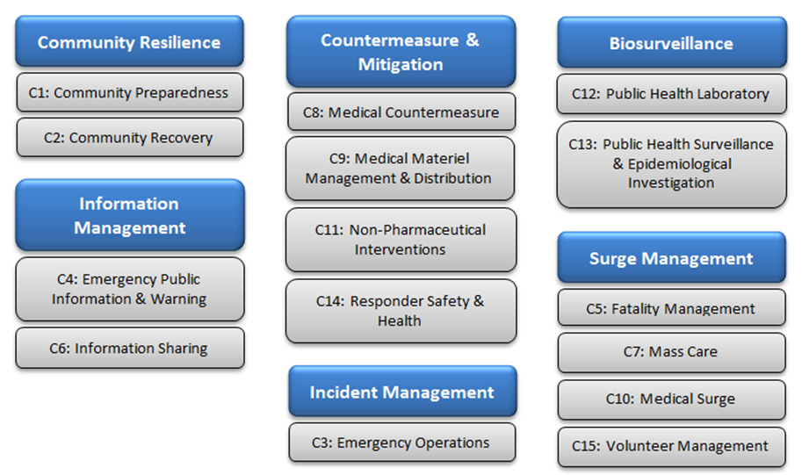
PHEP Domains & Capabilities

Slide 7
Next Years Grant 07/01/2018 BP1701-01Supp

Slide 8
Funding
For BP1701-01Supp funding to the local health jurisdictions (LHJs) will remain unchanged?
PHEP funding for BP1701-01Supp was reduced?
Payments:
Payment will be posted to the PHEP Deliverable resource (PDR) web page every Friday after the due date.
Email Notification

Slide 9
Concurrence Process
Why do we have the concurrence process?
Why is the time frame for review of deliverables so short?
Time line:
Grant received from CDC: 01/09/18
Grant Review Process: 1 - 2 weeks
CDC Work Plan Development & LHJ Deliverable Development: 6 - 8 weeks
Concurrence letters out: 3/12/18
Due Back: 3/30/18
Due Date: 4/9/18 - Submission Date 4/5/18

Slide 10
Contract Task-Orders are between DPHHS and the local health jurisdictions - Renewal of the Master Contract is June of 2019

Slide 12
Services to be Provided - LHJs
Collaborate and participate with others: LEPCs, TERCs, DES, Hospitals, etc.
Collaborate and communicate with DPHHS staff: Monthly call & grant workshop meetings.
Submit Progress Reports by the due date
Staffing Recommendations:
5,000 or less .5 FTE
5,000 to 20,000 .5 to 1.0 FTE
20,000 or more 1.0 to 2.0 FTE

Slide 13
Services to be Provided - State PHEP
Issue quarterly payments
Provide technical assistance, training, templates, guidelines, etc.
Provide access to resources, education materials, etc.
Website
Progress Reports
Collaborate and communicate with LHJs

Slide 14
Contract Period & Payments
July 1, 2018 to June 30, 2019
4 Quarterly Payments
No 10% payment this year
Deliverable Due Dates:
October 15th 2018
January 15th, 2019
April 15th, 2019
July 15th, 2019

Slide 15
Funding Conditions
Complete Deliverables
Submit Quarterly Progress Report
Extensions are allowable
Partial payments are allowable
All supporting documentation will be uploaded into your progress report.

Slide 16
Extensions
If you cannot meet the established deadline, you should request an extension
The link to request an extension is on the PDR Web Page
Extensions must be requested prior to the end of the quarter.
Extensions will not exceed 30 days past the end of the quarter (this can only be extended in rare circumstances on a case-by-case basis).

Slide 18
Extensions Requests by Quarter

Slide 19
Incomplete or Missing Deliverables
SME will contact the LHJ to discuss
SME will add note to the progress report and discuss with their supervisor.
Supervisor will reach out to LHJ
Final step Kevin will reach out to the LHJ to discuss missing deliverables.
If items are not submitted or corrected, payment will be withheld.
Kevin will review withholdings with Jim Murphy for concurrence.
The amount withheld depends on the number of deliverables due that quarter.

Slide 20
Expenditures Not Allowed
Recipients may not use funds:
To purchase of office furniture,
To purchase shirts, hats, etc.,
For fund raising activities or lobbying,
For construction or major renovations,
For clinical care,
Funds to purchase vehicles
Payments cannot be used as a match for another federal grant.

Slide 21
Funding Notes
Support accreditation activities that meet the PHAB preparedness-related standards.
Purchase caches of antiviral drugs to help ensure rapid distribution of medical countermeasures.
With prior approval, funds can be used to purchase industrial or warehouse-use trucks to be used to move materials.

Slide 22
Contract Liaison
PHEP Supervisor – Kevin O’Loughlin
406-444-1611 (w) 406-235-0377 (C)
Dispute Resolution Process: Jim Murphy

Slide 23
Deliverables

Slide 24
Admin Deliverable A1
Rita Karnopp 444-0919 or email @ rkarnopp@mt.gov

Slide 25
dropdowns
by name
Rita
rkarnopp@mt.gov
by email

Slide 26
One click: edits, details & reviewed

Slide 27
The new MPHD Should be Available by August 1st

Slide 28
Admin Deliverable A2
Kevin O’Loughlin - 444-1611 or email @ koloughlin@mt.gov

Slide 29
A2 - End of Year Report - Due 4th Qtr.
Each LHJ must submit a brief narrative to describe its preparedness.
The purpose of is to begin a record of accountability for the use of PHEP Funds.
The report must describe how PHEP funding has improved your preparedness.
Activation of any of your response plans and participation in exercises.
Suggest areas of preparedness in which your jurisdiction could use more assistance.

Slide 30
Budget Deliverables
Dan Synness 406-444-6927 or email @ dsynness@mt.gov

Slide 31
Budget Deliverables
1st Quarter
B1 - Staffing Summary
2nd Quarter
B2 - In-Kind Estimates
4th Quarter
B3 - Actual Budget
B4 - Equipment Inventory List
PHEP approves single item purchases over $25,000
PHEP must track and report equipment purchases over $5,000

Slide 32
Continuity of Operations (COOP)
Dana Barnicoat - 444-1305 or email @ dana.Barnicoat@mt.gov

Slide 33
Continuity of Operations (COOP)
C1 - Delegation of Authority Due 2nd Quarter
Highlights
Develop and update Transfer of Authority and Successor Responsibilities Guidelines.
COOP C2 - Due: 3rd Quarter
Highlights
Complete one COOP training either in person or online within the budget period and report in the third quarter.

Slide 34
Odds and Ends
Full Scale Exercise 2019
Carryover
Resources
Submission Rates
Website – Back page for LHJ Resources
Health Care Coalitions

Slide 35
Full Scale Exercise in 2019
PHEP Impact Project
CDC Preparedness Report

Slide 36
Carryover
Why the $10,000 limit?
Is everyone getting $10,000?
Change in process
CDC Approval

Slide 37
LHJ Training/Exercises
If you are conducting training or exercises, please let us know.
if it open for anyone to attend or limited audience.
We want to add the training or exercises to our calendar and the Ready and Safe page.

Slide 38
Resources
If you are hosting a meeting or conducting an exercise that you would like us to attend please let Kevin know we are more willing to participate.
If you are having a PHEP multi-county meeting and need to use our bridge lines please contact Kevin or Rita.
Conference space in our building
Communications trailer

Slide 39
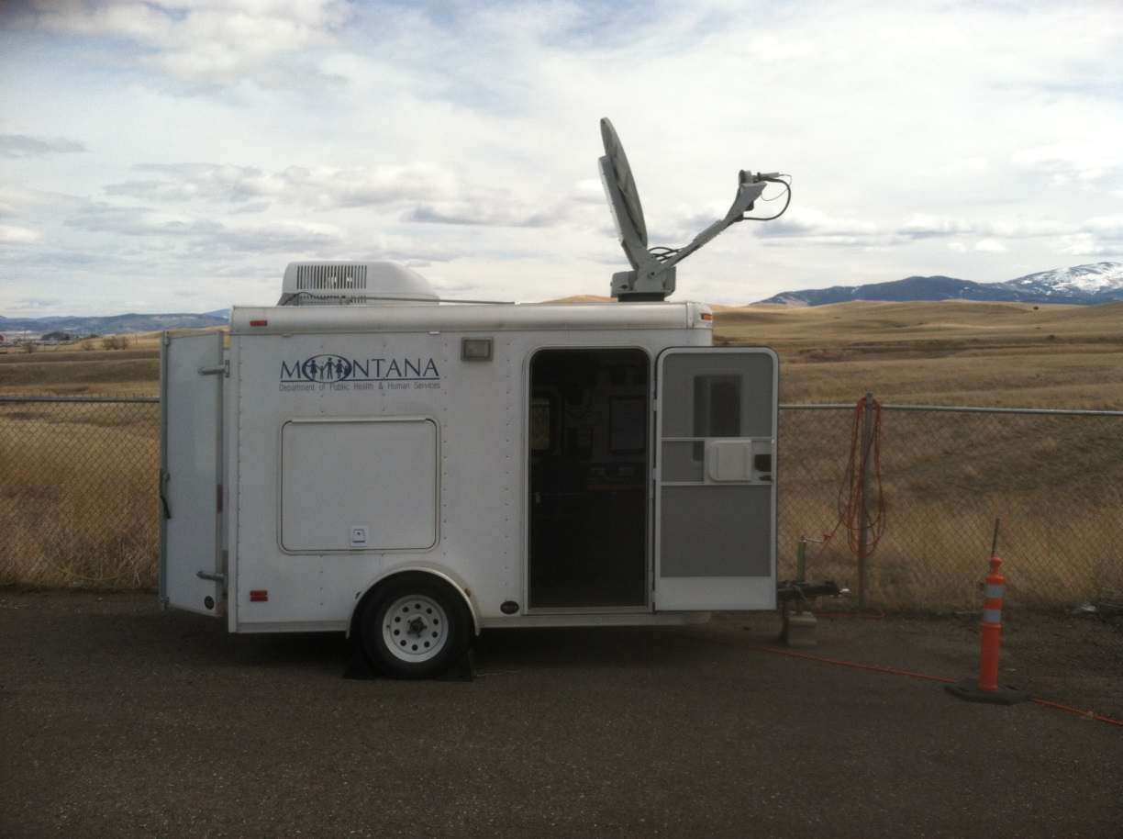
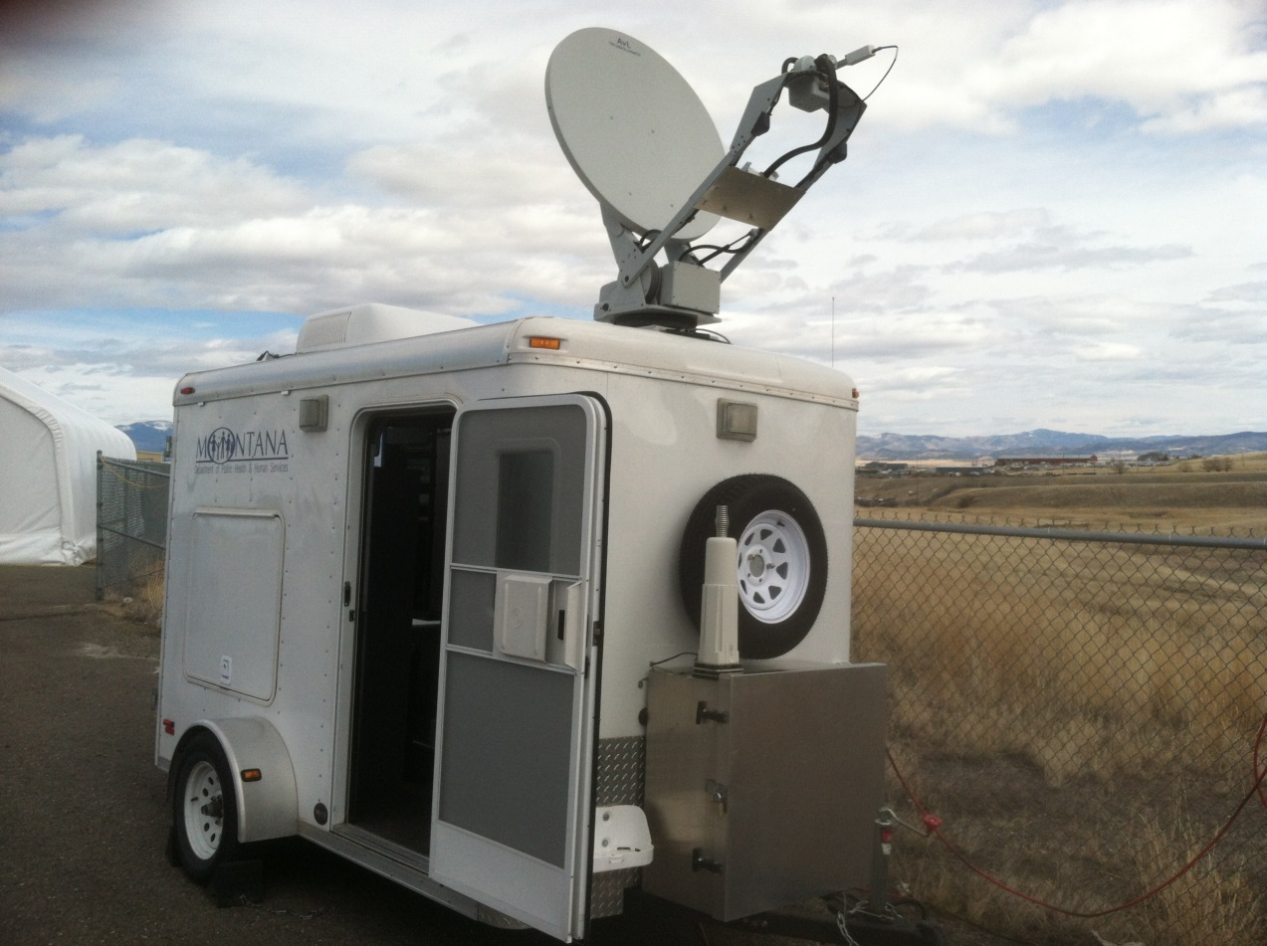

Slide 40
LHJ Submission - On Time Goal is 90%
71%
75%
74%
86%
83%
76%
69%
86%
86%

Slide 41
PHEP Deliverables Resource (PDR)
The PHEP PDR webpage.
The site is only to retrieve the documents and templates you need for your deliverables.
If you think of anything you would like us to add.

Slide 42
Webinars
July 1st the State will be switching to Skype for webinars
What does this mean for me?

Slide 43
Lincoln
Blackfeet
Hill
Daniels
Sheridan
Glacier
Toole
Blaine
Liberty
Ian
Flathead
Phillips
Fort Peck
Pondera
Rocky Boy’s
Fort Belknap
Roosevelt
Dana
Valley
Sanders
Lake
Teton
McCone
Richland
Chouteau
Margaret
CSKT
Mineral
Cascade
Fergus
Garfield
Dawson
Lewis & Clark
Judith Basin
Petroleum
Missoula
Wibaux
Powell
CMHD
Prairie
Meagher
Golden
Valley
Rosebud
Gerry
Granite
Wheatland
Musselshell
Ravalli
Broadwater
Fallon
Deer Lodge
Jefferson
Treasure
Custer
Silver Bow
Sweet Grass
Yellowstone
Luke
Gallatin
Park
Stillwater
N. Cheyenne
Madison
Crow
Carter
Matt
Powder River
Beaverhead
Carbon
Big Horn
Tribes: Gary

Slide 44
Preparedness Summit

Slide 45
Health Care Coalitions

Slide 46
Membership.

Slide 47
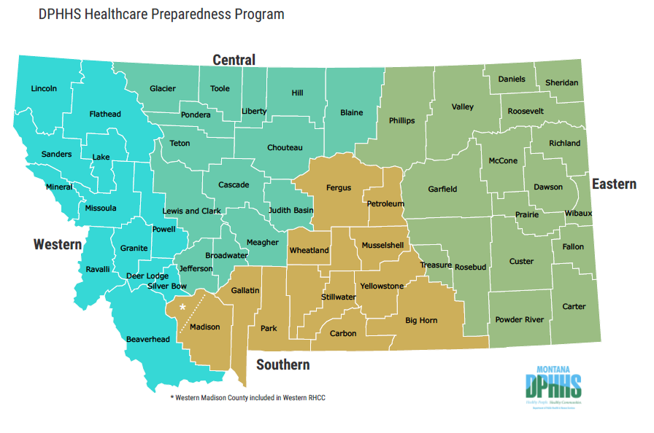
Regions, July 1 2018

Slide 48
East RHCC Executive Committee
Robbie Kavon, Sheridan Memorial Hospital
Todd Opp, Glendive Medical Center and EMS
Sue Casperson, Sidney Health Center
Lois Leibrand, Daniels County Public Health
Marilyn Usselman, Nursing Home (Sidney)
Dennis Four Bear, Fort Peck Tribes (newly added)
Jeff Gates, State Disaster and Emergency Services (DES)
Vacant
Vacant
Vacant
Vacant
Vacant
Vacant
Vacant
Vacant
No Vote Vacant, Dana Barnicoat, DPHHS PHEP
Gary Zimmerman, DPHHS PHEP
Cindee McKee, MT Hospital Association
Don McGiboney, DPHHS HPP
Bryan Tavary, DPHHS HPP

